Slide 1
Canada PR Data Visualization BDM-1043 Project Fall 2022

Slide 2
MEMBERS
Auradee Castro
Bhumika Rajendra Babu
Lakpa Sherpa
Pradeep Kumar Bhatt
Varun Sharma

Slide 3
Project Goal
To provide data visualization and conduct data analysis on Canada Permanent Residence (PR) approvals for the last 5.75 years (from January 2017 to September 2022)
Scope of the data analysis
Admission by Province and National Occupation Category (NOC)
Admission by Province and Immigration Category
Admission by Province and Age Group

Slide 4
Data Collection
The datasets for Canada Permanent Residents are taken from Permanent Residents – Monthly IRCC Updates, which provides records from January 2015 to September 2022
Data included on data analysis
Admission by Province and National Occupation Category (NOC)
Admission by Immigration Category
Admission by Province and Age Group
The figures in datasets are suppressed or rounded to prevent identification of individuals. The reports can only give rough estimate of the total approvals, and not the actual ones.
Notes:
The figures in datasets are suppressed or rounded to prevent identification of individuals -> This may result to the sum of the figures not equating to the totals indicated.

Slide 5
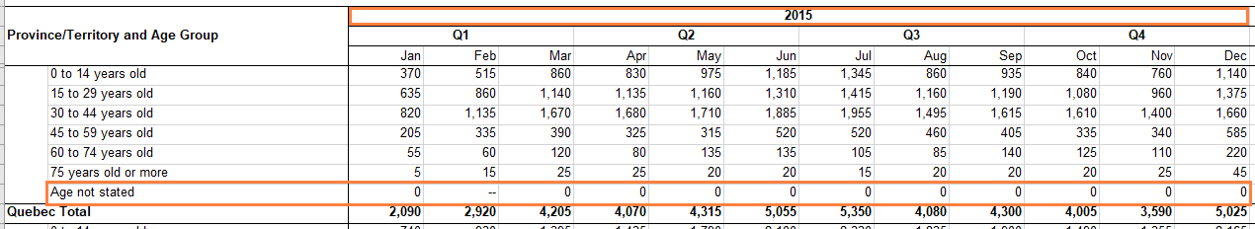
Data Cleansing
Data that are excluded from data analysis
Zero (0) values in the report
Values between 0 and 5 that are shown as “--” in the report
All records for year 2015 and 2016
For NOC: All records under “Other occupations” and “Occupation Not Stated”
For Immigration Type: All records under “All Other Immigration”
For Age Group: All records under “Age Not Stated”

Slide 6
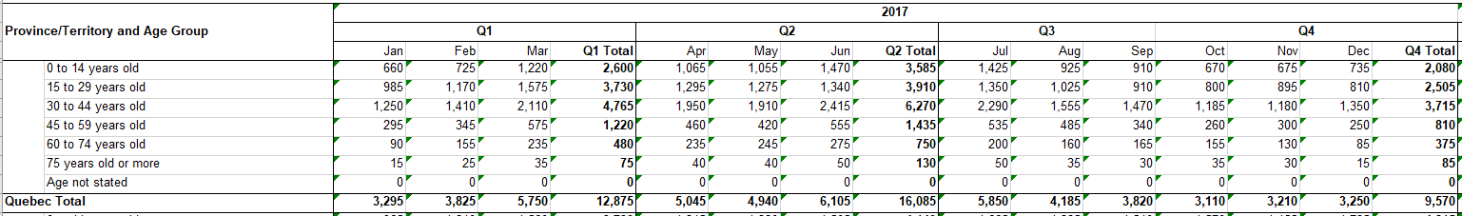
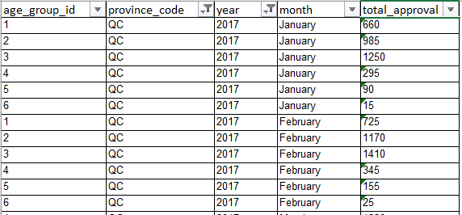
Data Transformation
Transformed data to a format that could be ingested by Hive
Re-arranged each row of the records by month, year, province and NOC/Immigration Category/Age Group
Converted to CSV file

Slide 7
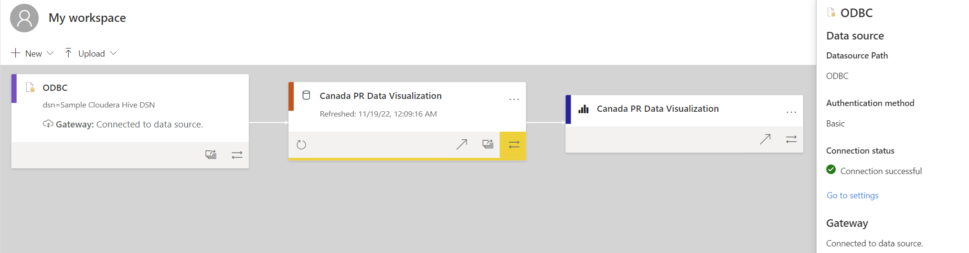
Tech Stack
Lineage from the data source (Cloudera) to Power BI datasets and visualization report
Cloudera + Hortonworks – to manage and store the data
Hadoop
Hive
Microsoft Power BI – to create data visualization report

Slide 8
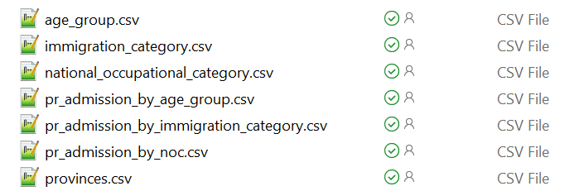
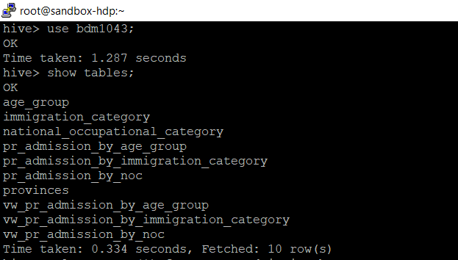
Hadoop and Hive (Cloudera + Hortonworks)
Files for data import
Hadoop and Hive is used to manage and store the datasets
Seven tables are created in Hive
Each table is loaded with data from the respective CSV file
View is created for each pr_admission_by_* table
Tables and views created in Hive

Slide 9
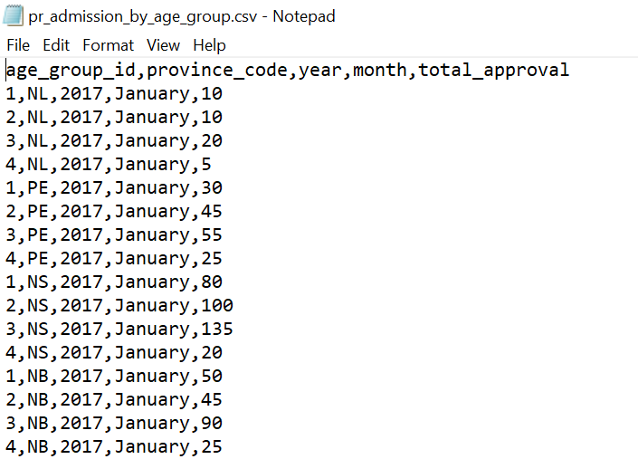
Hadoop and Hive (Cloudera + Hortonworks)
create table if not exists pr_admission_by_age_group (
age_group_id int comment 'age group id’,
province_code string comment 'province code
year int comment 'year of the PR approval’,
month string comment 'month of the PR approval’,
total_approval int comment 'total number of PR approvals’
)
row format delimited
fields terminated by ','
lines terminated by '\n'
stored as textfile
tblproperties ("skip.header.line.count"="1");
load data local inpath '<dir>/pr_admission_by_age_group.csv'
into table pr_admission_by_age_group;
Sample script for table creation and data load, and snapshot of the data for import
Complete list of Hive scripts and CSV files for data import
hive scripts
csv for data import

Slide 10
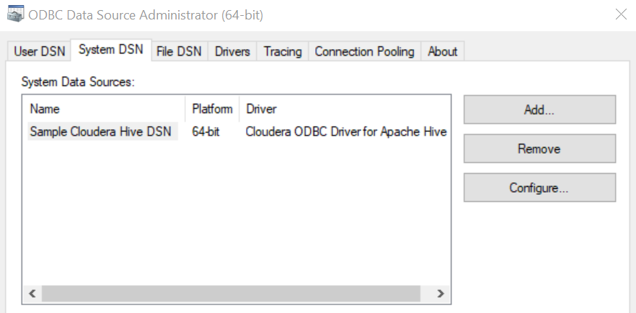
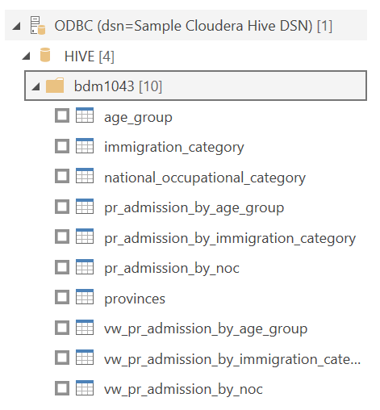
Microsoft Power BI
ODBC is used to connect and import data from Hive tables and view on Hortonworks sandbox
Steps to add Cloudera + Hortonworks in ODBC Data Source

Slide 11


CANADA PR DASHBOARD FROM POWER BI
View in Power BI

Slide 12
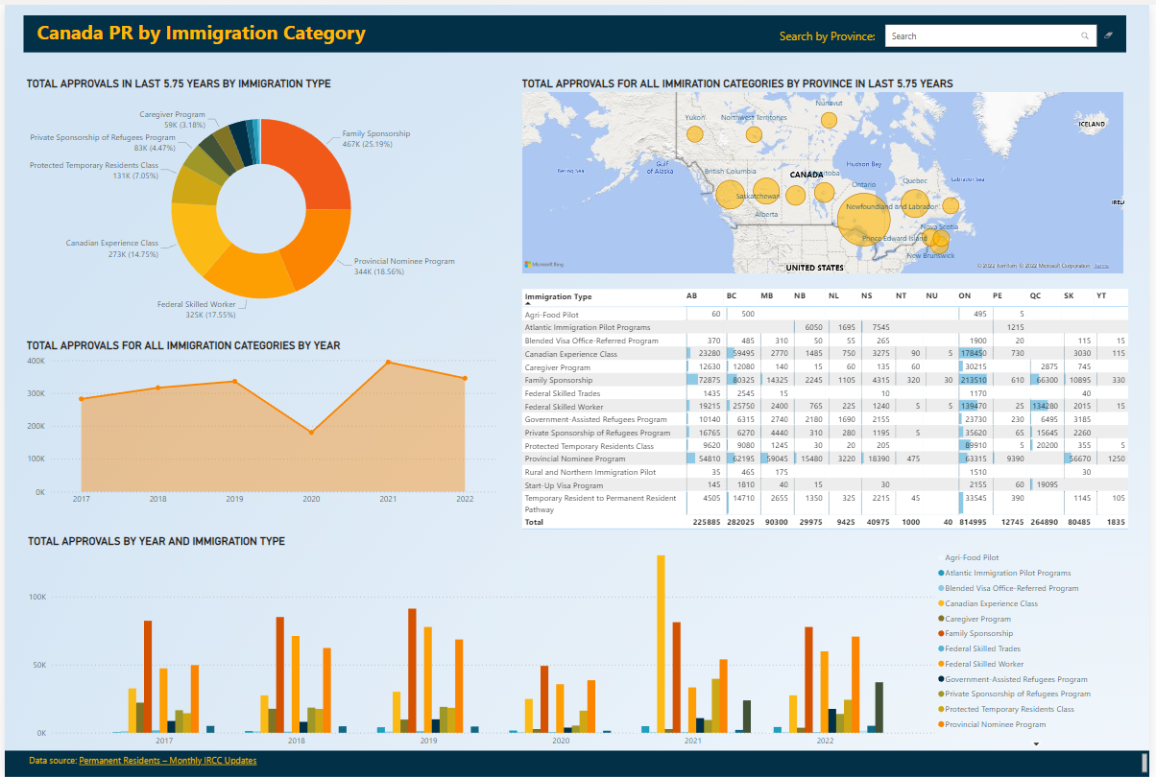

Slide 13
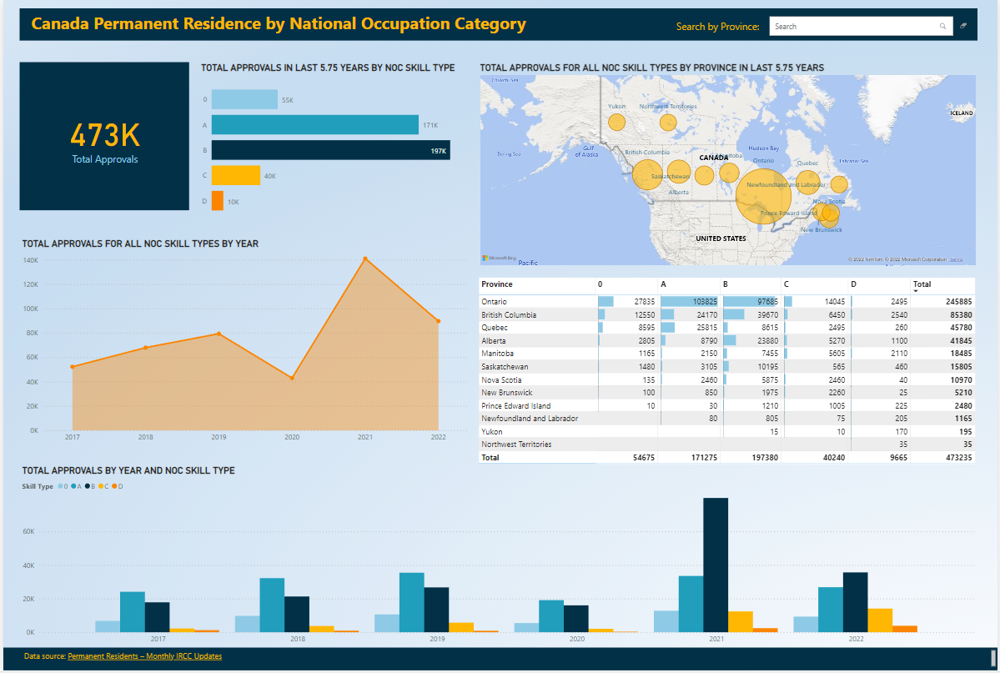

Slide 14
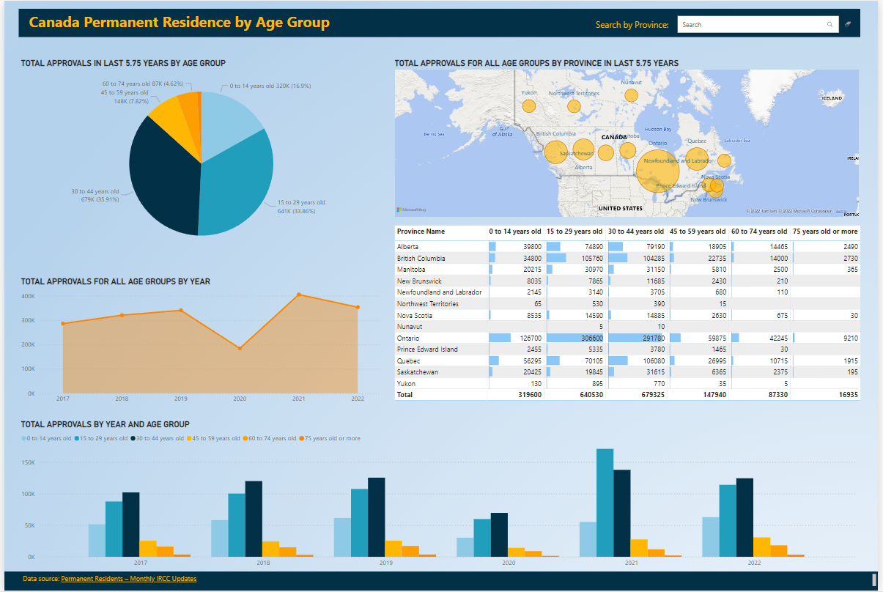

Slide 15

Canada Permanent Residence by Immigration Category

Slide 16
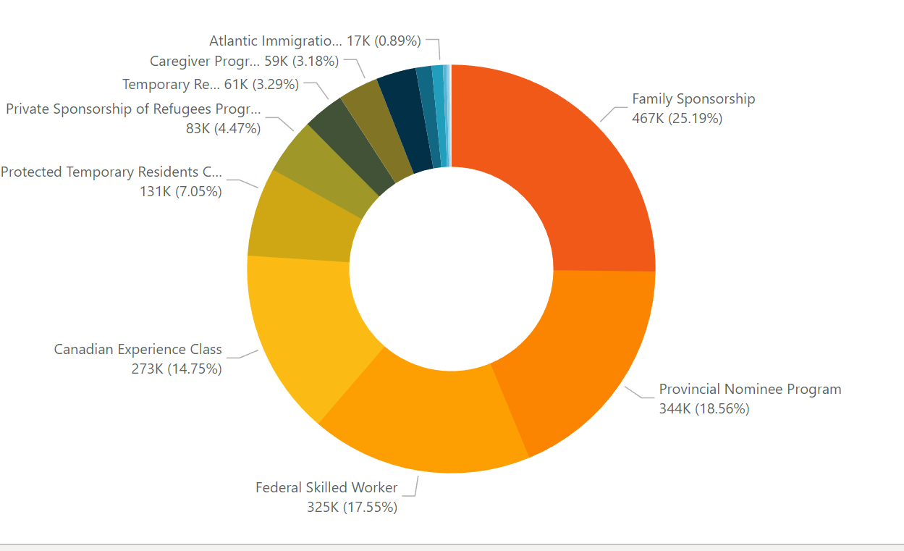
Total Approvals in last 5.75 years by immigration type
The highest number of approvals are from immigration type Family Sponsorship which is around 467k (25.19%) followed by Provincial Nominee Program with 344k (18.56%)
The lowest approvals are from Rural and northern immigration pilot program which is around 2215 (0.12%)
Notes:
Family Sponsorship: Alberta, British Columbia, Ontario
Provincial Nominee Program: Manitoba, New Brunswick, Newfoundland and Labrador, Northwest Territories, Nova Scotia, Nuvavut, Prince Edward Island, Saskatchewan, Yukon

Slide 17
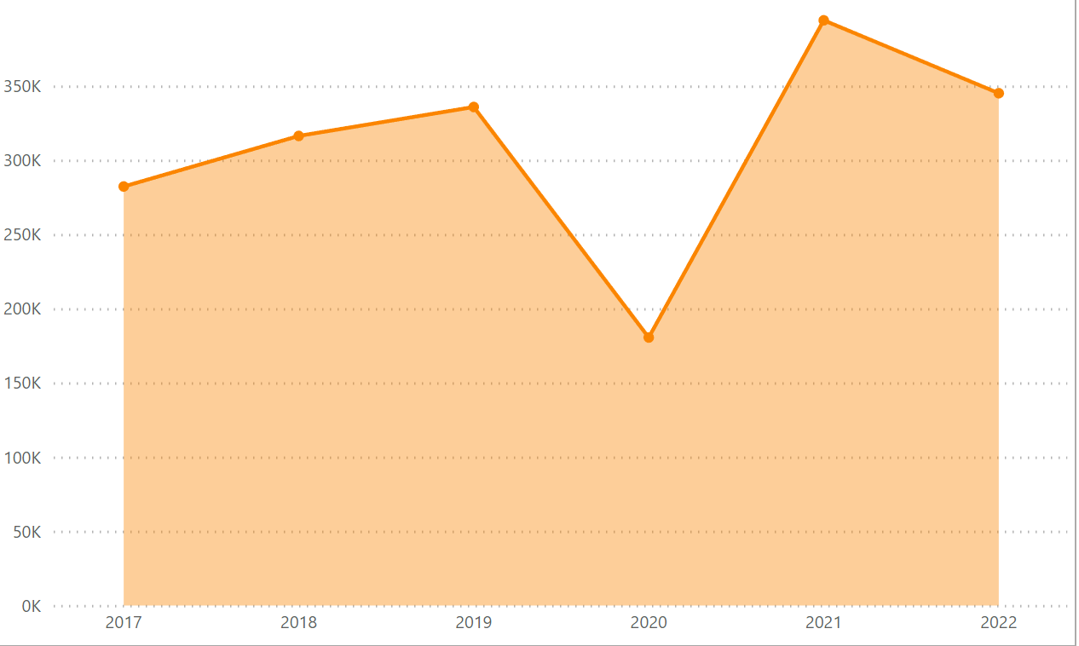
Total approvals for all immigration categories by year
The highest number of approvals were in year 2021 which is around 394k due to the introduction of TR to PR program and the mass approval on CEC applicants
Also, we can see a dip in the approvals in 2020 due to COVID19 pandemic. The approvals were around 180k which is way less than the previous year which had around 335k approvals

Slide 18
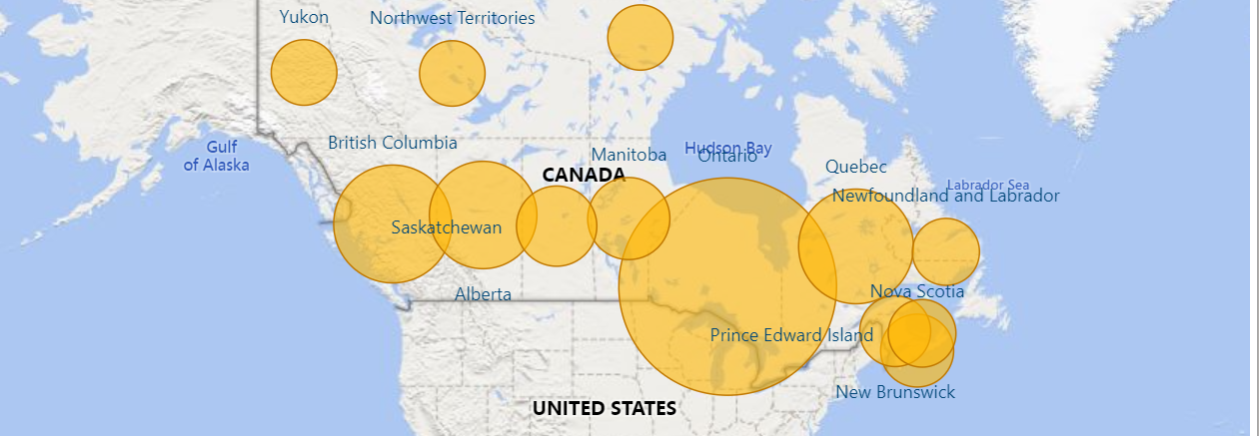
TOTAL APPROVALS FOR ALL IMMIRATION CATEGORIES BY PROVINCE IN LAST 5.75 YEARS
The highest number of approvals are from province of Ontario which is around 814k followed by British Columbia with 282k
Whereas the least number of immigrants were from Nunavut which is around 40

Slide 19
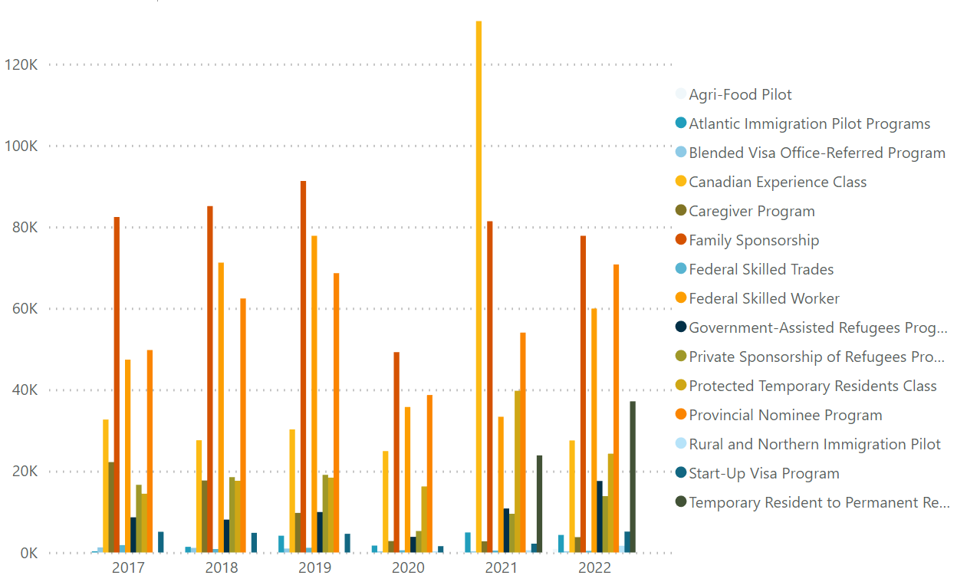
Total Approvals by Year and Immigration Category
Highest number of approvals were in 2021 for CEC category
Most number of approvals across all years is from Family sponsorship category
Least number of approvals is from Rural immigration program in year 2021
Notes:
High number of approvals in 2021 for CEC category -> mostly comprised of Ontario and British Columbia

Slide 20
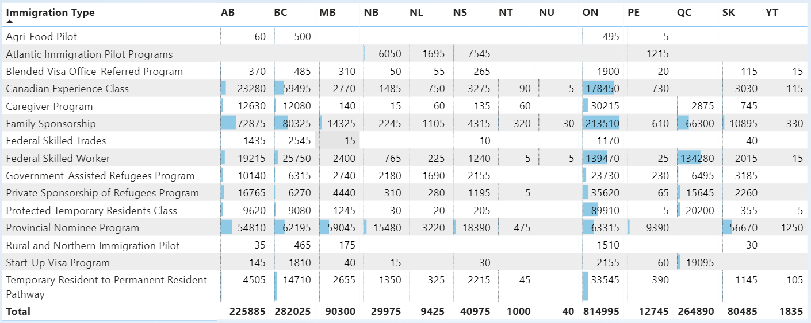
Summary

Slide 21
Canada Permanent Residence by National Occupation Category

Slide 22
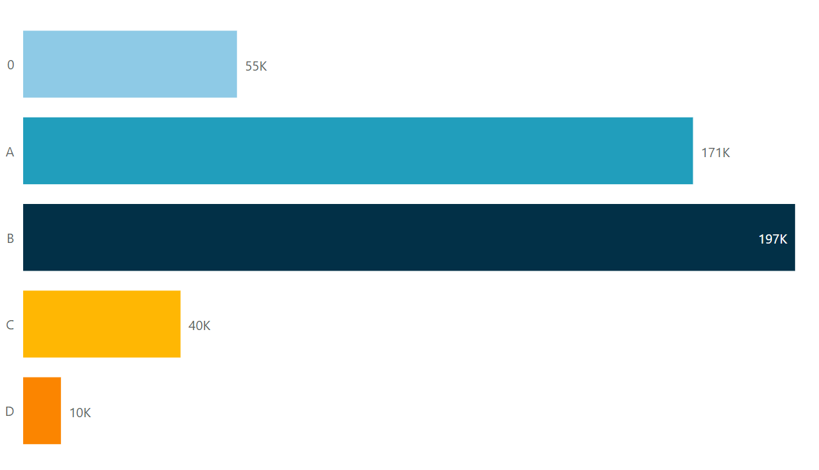
Total Approvals in last 5.75 years by NOC Skill Type
Highest number of approvals are from NOC B which is around 197k
Lowest number of approvals are from NOC D which is around 10k
Notes:
Skill Type 0: management jobs (e.g. factory managers, restaurant managers, or office managers)
Skill Level A: professional jobs that usually call for a degree from a university (e.g. chemists, architects, or pharmacists)
Skill Level B: technical jobs and skilled trades that usually call for a college diploma or training as an apprentice (e.g. chefs, electricians, plumbers)
Skill Level C: intermediate jobs that usually call for high school and/or job-specific training (e.g. truck drivers, industrial butchers, or food and beverage servers)
Skill Level D: labour jobs that usually give on-the-job training (e.g. fruit pickers, cleaning staff, oil field workers)

Slide 23
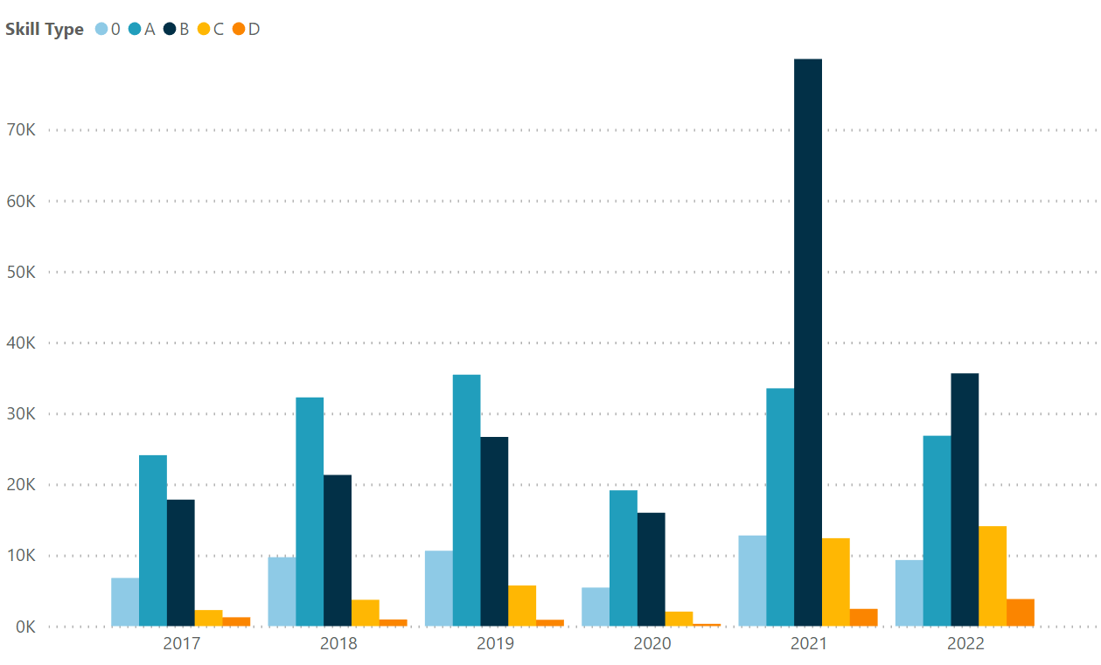
Total Approvals by
Year and NOC Skill Type
NOC A has the highest approvals for 2017 to 2020. The increase of approvals for NOC B has started on 2021 due to TR to PR program and CEC approvals
NOC D has the lowest approvals for all years
Notes:
The surge of approvals for NOC B has started on 2021 -> caused by of TR to PR program and the mass approval on CEC applicants

Slide 24
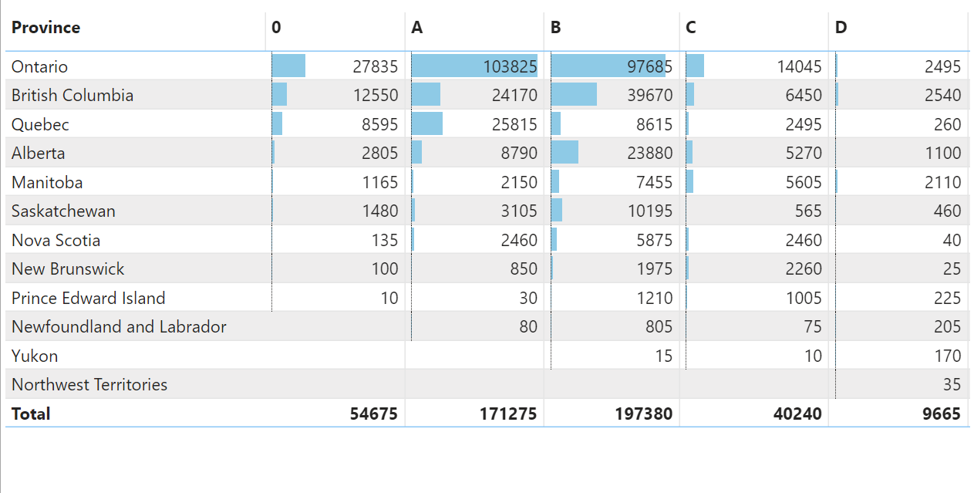
Summary of approval by NOC Skill Type per Province
Most Approvals
NOC 0 - Ontario
NOC A - Ontario
NOC B - Ontario
NOC C - Ontario
NOC D - British Columbia
Least Approvals
All provinces under Northern Territories region (Nunavut, Northwest Territories and Yukon) have the least number of approvals for all NOC skill types

Slide 25
Canada Permanent Residence by Age Group

Slide 26
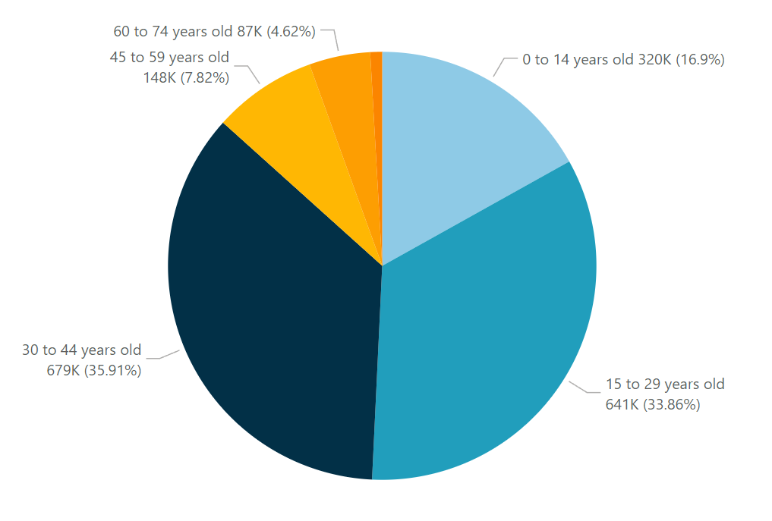
Total Approvals in last 5.75 years by Age Group
Highest number of approvals were from age group 30-44 years old
Least number of approvals were from age group 75 years old and above

Slide 27
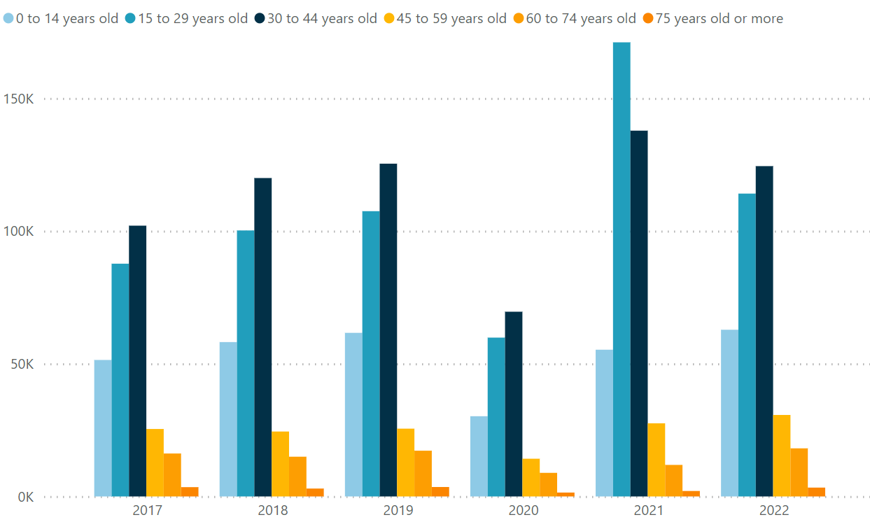
Total Approvals by Year and Age Group
Highest number of approvals in a particular year were from age group 15-29 years old in year 2021
Least number of approvals are from the age group 75 and above for all years
Notes:
Highest number of approvals in a particular year were from age group 15-29 years old in year 2021 -> caused by of TR to PR program and the mass approval on CEC applicants. In addition, FSW program, which contributes to the big percentage for 30 to 44 years old, was temporarily paused

Slide 28
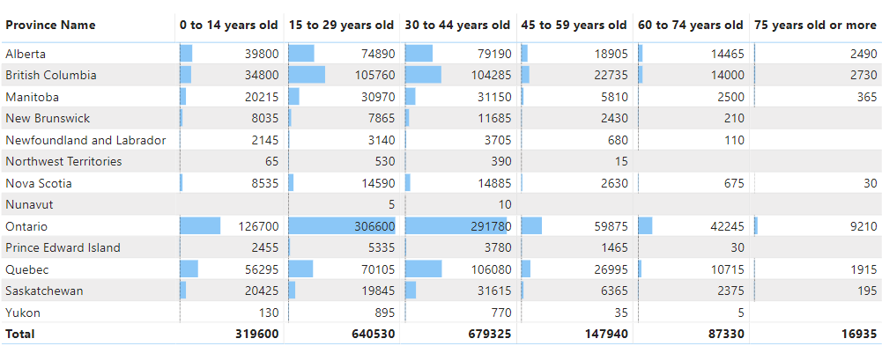
Summary

